Slide 1
Local Alcohol Profiles for England https://fingertips.phe.org.uk/profile/local-alcohol-profiles
Responsible statistician: Mark Cook
For queries relating to this document, please contact: lape@phe.gov.uk
First published: December 2018
© Crown copyright 2018
Re-use of Crown copyright material (excluding logos) is allowed under the terms of the Open Government Licence, visit www.nationalarchives.gov.uk/doc/open-government-licence/version/2/ for terms and conditions

Slide 2
Local Alcohol Profiles for England: December 2018
Main Findings
1.02 Years of life lost due to alcohol-related conditions
There were over 307,000 potential years of life lost in 2017 due to alcohol consumption.
Potential years of life lost for men (219,082) are more than double the number for women (88,137).
The inequality gradient is particularly steep for years of life lost due to both a higher rate of alcohol-related deaths in more deprived areas and a younger average age at death.
2.01 Alcohol-specific mortality
There were 16,656 alcohol-specific deaths in England between 2015 and 2017, a rise of 2.8% compared to the previous 3-year period. This is the largest increase since the start of LAPE and also the third successive increase.
There is marked variation in alcohol-specific mortality rates across local authorities in England, ranging from 3.0 per 100,000 population in South Oxfordshire to 30.1 per 100,000 population in Blackpool.
What’s new in LAPE?
This update of the Local Alcohol Profiles for England (LAPE) tool will include new data for the following indicators: years of life lost due to alcohol-related conditions (2017), alcohol-specific mortality (2015-17), mortality from chronic liver disease (2015-17), alcohol-related mortality (2017).
Methods used in LAPE
Information about the methods used to generate the indicators in LAPE can be found in the definitions tab on the LAPE site: https://fingertips.phe.org.uk/profile/local-alcohol-profiles
A full explanation of alcohol-attributable fractions and indicator revisions can be found in the LAPE User Guide: https://fingertips.phe.org.uk/documents/LAPE_2017_User_Guide_071117.pdf

Slide 3
Local Alcohol Profiles for England: December 2018
Main Findings
3.01 Mortality from chronic liver disease
There were 18,907 deaths from chronic liver disease between 2015 and 2017, a 2.6% increase compared to the previous 3-year time period. This is not as significant an increase as seen between 2014 and 2016 (3.7%); the latter remains the largest increase since the start of the LAPE series.
Again, the number of deaths from chronic liver disease for men (12,008) was almost double the number for women (6,899).
4.01 Alcohol-related mortality
In 2017 there were an estimated 24,208 deaths attributed to alcohol use in England. This is an increase of 1.5% since 2016 and the fifth consecutive annual rise.
The contribution that alcohol makes to mortality varies considerably by age. Whilst there are a greater number of alcohol-related deaths at older ages, as a proportion of all deaths alcohol is most significant for younger adults.
Key definitions used in LAPE
To access the Local Alcohol Profiles for England dataset by local authority see our interactive data tool here

Slide 4
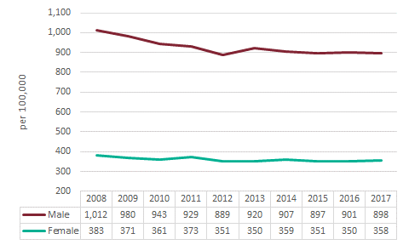
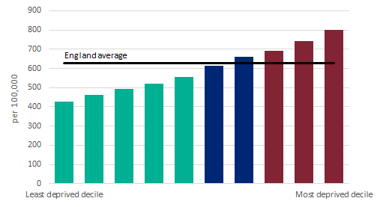
Local Alcohol Profiles for England: December 2018 Years of life lost due to alcohol-related conditions
In 2017 there were an estimated 307,209 years of life lost in England up to the age of 75 (a rate of 626 years lost per 100,000 in the population).
The number of years of life lost increased by 0.4% in the latest year. However, the 2017 figure is almost 10% lower than the beginning of the time series (2008).
Potential years of life lost for men (219,082) are more than double the number for women (88,137).
The inequality gradient is particularly steep for years of life lost due to both a higher rate of alcohol-related deaths in more deprived areas and a younger average age at death. Half of the years of life lost in 2017 were from the most deprived 30% (Figure 2).
Figure 1. Years of life lost due to alcohol-related conditions by gender, England (Note: y-axis does not start at zero)
Figure 2. Years of life lost due to alcohol-related conditions by deprivation decile, England

Slide 5
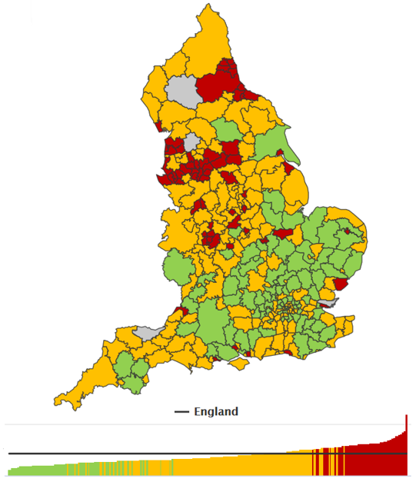
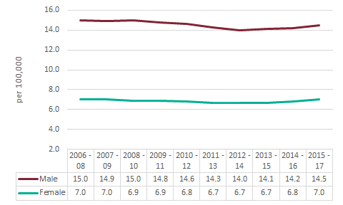
Local Alcohol Profiles for England: December 2018 Alcohol-specific mortality
There were 16,656 alcohol-specific deaths in England between 2015 and 2017, a rise of 2.8% compared to the previous 3-year period. This is the largest increase since the start of the time period (2006-2008) and also the third successive increase.
By gender there was an increase of 3.5% in deaths for females and 2.5% for males. However, the number of alcohol-specific deaths for men (11,048) is almost double the figure for women (5,608).
Figure 3. Alcohol-specific mortality by gender, England (Note: y-axis does not start at zero)
Figure 4 shows the variation in alcohol-specific mortality rates across local authorities in England, ranging from 3.0 per 100,000 population in South Oxfordshire to 30.1 per 100,000 population in Blackpool.
Figure 4. Alcohol-specific mortality, District & UA

Slide 6
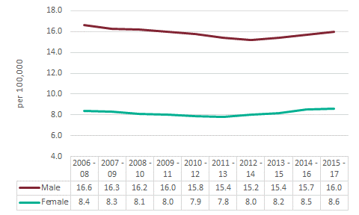
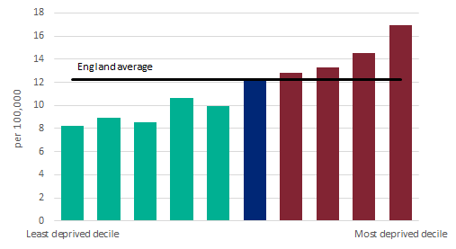
Local Alcohol Profiles for England: December 2018 Mortality from chronic liver disease
There were 18,907 deaths from chronic liver disease between 2015 and 2017, a 2.6% increase compared to the previous 3-year time period (18,425). This is not as significant an increase as seen between 2014 and 2016 (3.7%); the latter remains the largest increase since the start of the LAPE series. By gender the increases are fairly similar – 2.8% for men and 2.3% for women. Again however, the number of deaths from chronic liver disease for men (12,008) was almost double the number for women (6,899).
The rate of chronic liver disease mortality in the most deprived areas (16.9 per 100,000) is almost double the rate in the least deprived (8.9 per 100,000).
Figure 5. Mortality from chronic liver disease by gender, England (Note: y-axis does not start at zero)
Figure 6. Mortality from chronic liver disease by deprivation decile, England

Slide 7
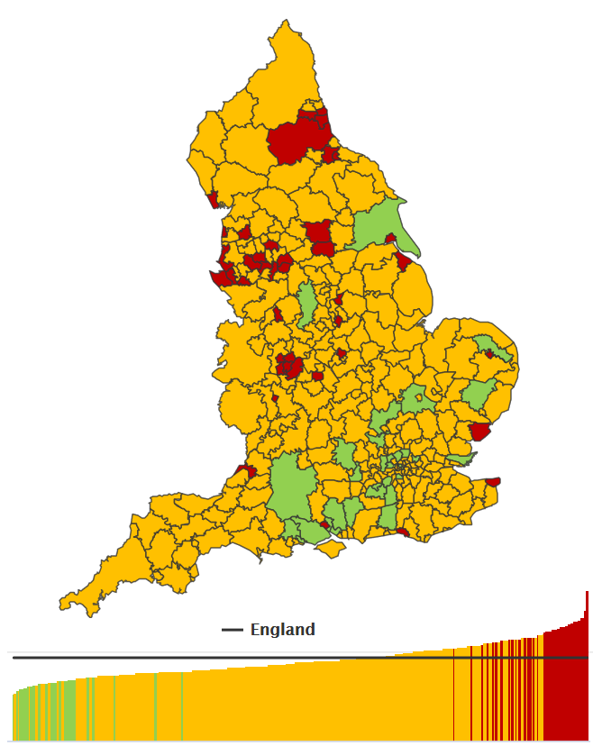
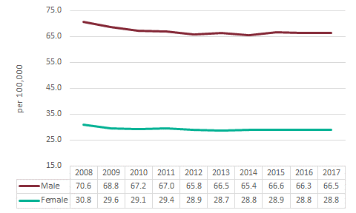
Local Alcohol Profiles for England: December 2018 Alcohol-related mortality
In 2017 there were an estimated 24,208 deaths attributed to alcohol use in England. This is an increase of 1.5% since 2016 and the fifth consecutive annual rise. As seen in many other alcohol indicators, there is a marked and persistent gender inequality observed for alcohol-related mortality – the rate for men is currently more than double the rate for women.
The contribution that alcohol makes to mortality varies considerably by age. Whilst there are a greater number of alcohol-related deaths at older ages, as a proportion of all deaths alcohol is most significant for younger adults.
Figure 7. Alcohol-related mortality by gender, England (Note: y-axis does not start at zero)
Figure 8 shows the variation in alcohol-related mortality rates across local authorities in England, ranging from 26.2 per 100,000 population in South Oxfordshire to 84.6 per 100,000 population in Blackpool.
Figure 8. Alcohol-related mortality, District & UA

Slide 8
Local Alcohol Profiles for England: December 2018
Future LAPE releases
The Local Alcohol Profiles for England (LAPE) have been published since 2006. These profiles have been designed to help local government and health services assess the effect of alcohol use on their local populations. They inform commissioning and planning decisions to tackle alcohol use and improve the health of local communities.
Hospital admissions update: February 2019
The HES-based indicators are scheduled for update in February 2019. At the same time as the LAPE indicators are updated the ‘Alcohol-related hospital admissions – Statistical tables for England’ (formerly produced by the HSCIC) will also be updated. Previous version (February 2018) is available here: https://fingertips.phe.org.uk/profile/local-alcohol-profiles/supporting-information/additional-data

